Slide 1
Predictive Data Mining – basketball playoffs qualification
André Sousa up202005277
Pedro Fonseca up202008307
Tomás Maciel up
AC – Machine Learning 2023/2024

Slide 2
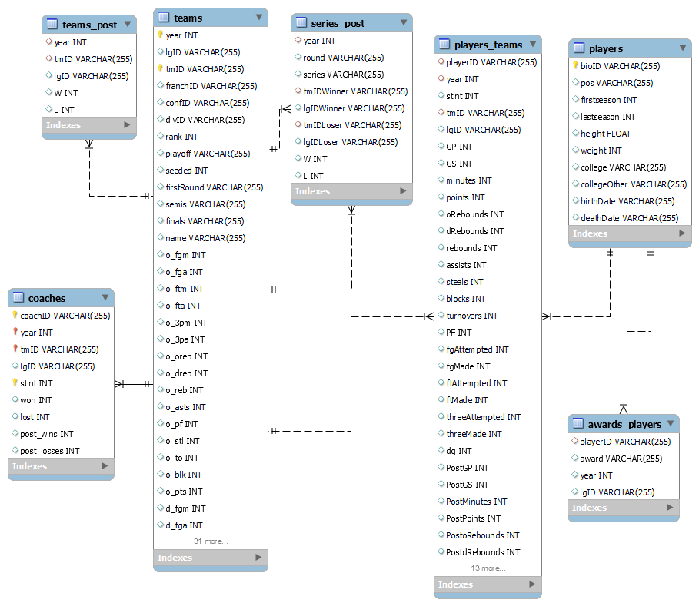
Domain description
For 10 seasons (years) data from players, teams, coaches, games, and several other metrics were gathered and arranged on this dataset.
Our main goal is, using this data, to develop a model that can predict which teams go to the (8 first teams).

Slide 3
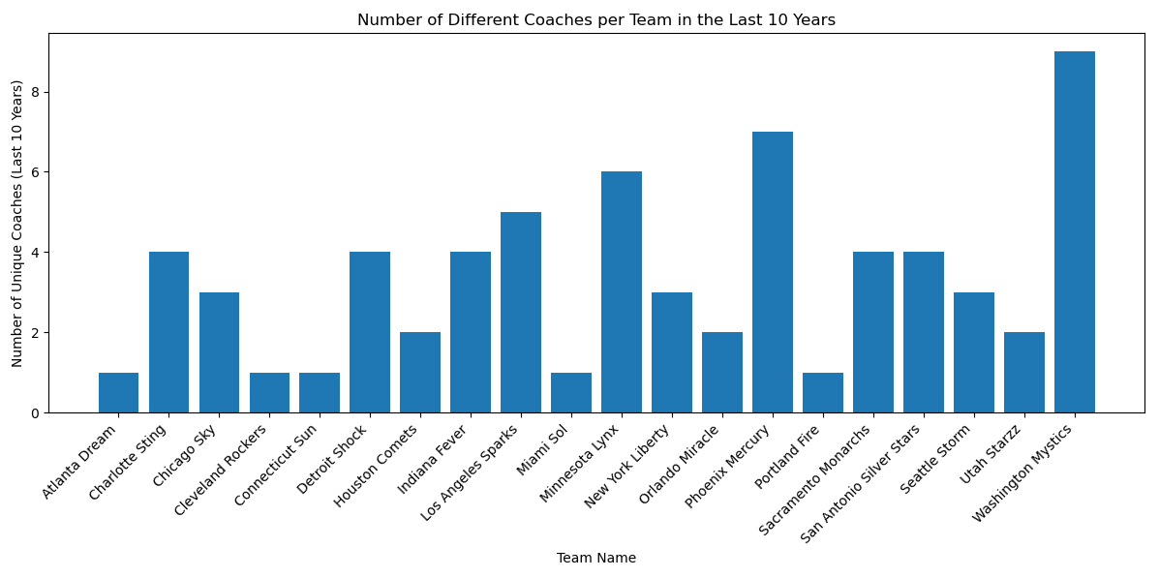
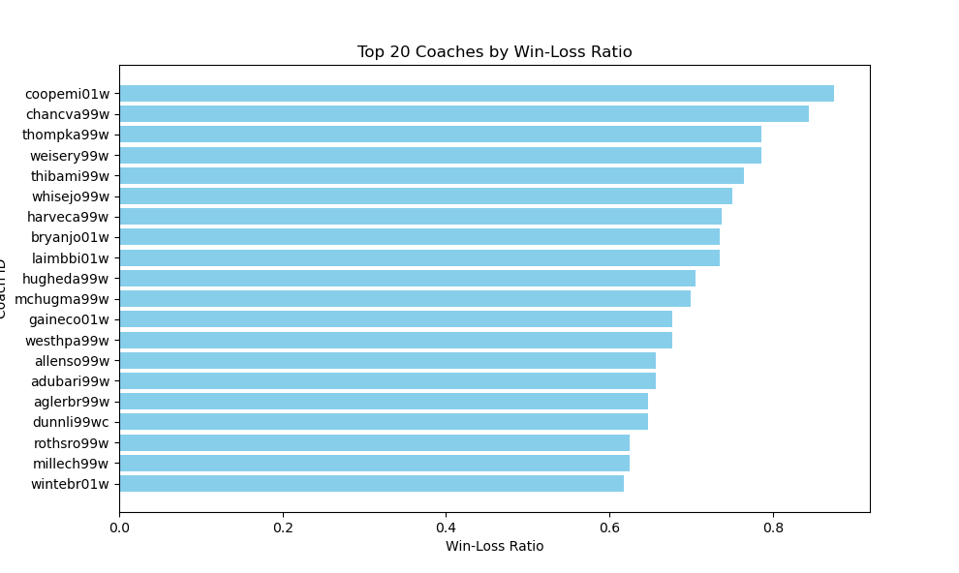
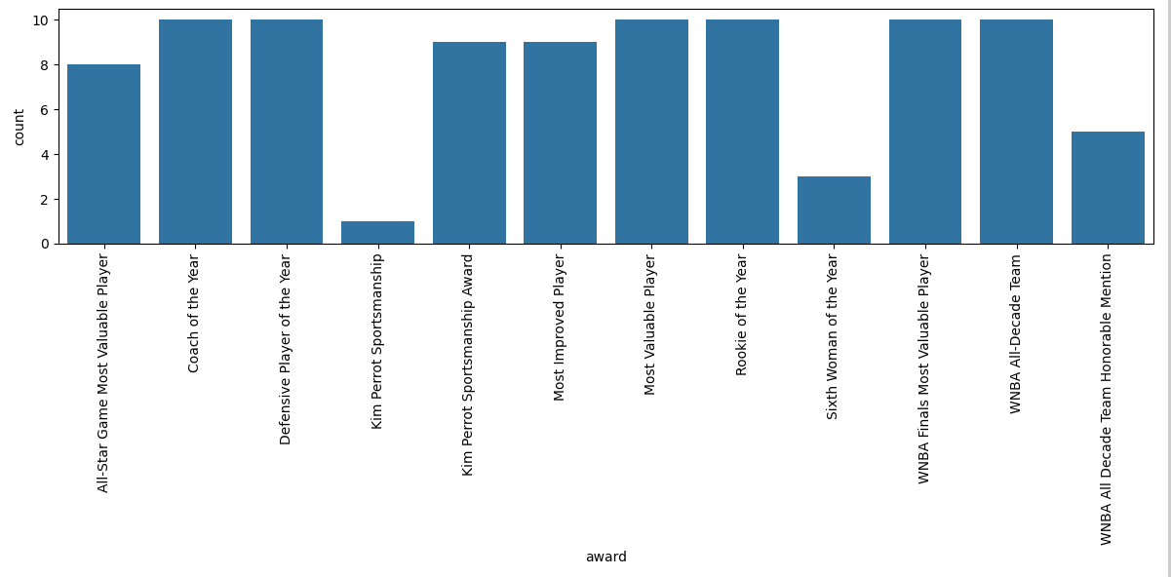
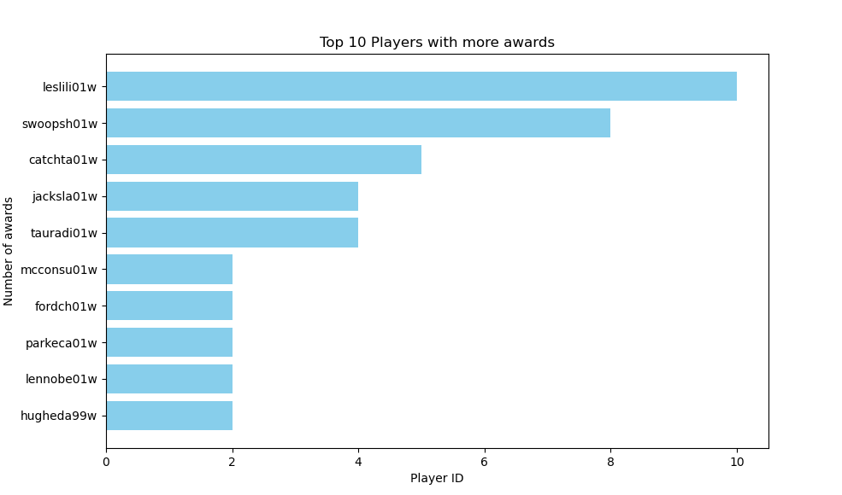
Exploratory Data Analysis
1
1- There are teams with different coaches over the 10 years, however, a few kept the same coach. There are also teams that switched coaches during the season.
2- The 20 coaches with the higher Win-Loss Ratio.
3 – The top 10 players with the most awards won, which suggests us the best players.
4 – The number of awards given to players.
2
3
4

Slide 4
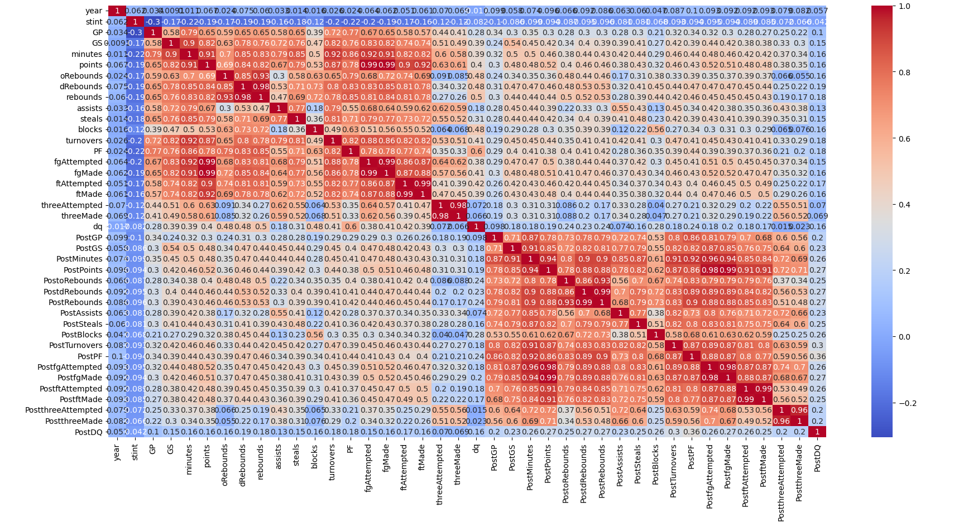
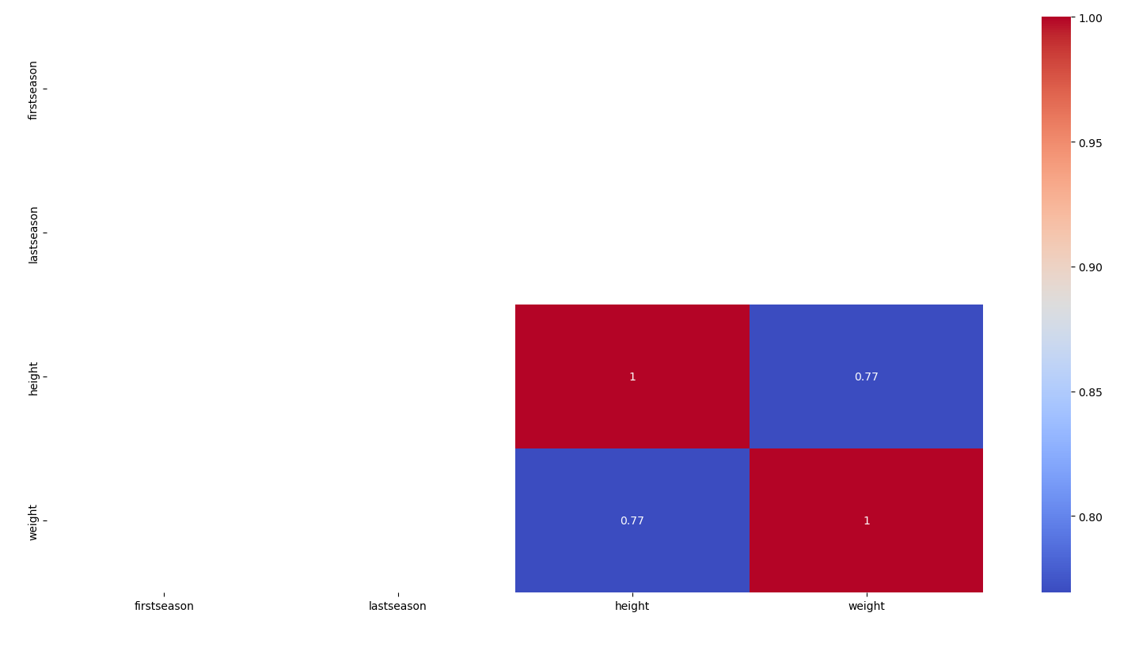
Exploratory Data Analysis
7
Team | Playoff Appearances
0 LAS | 9
1 SAC | 8
2 DET | 7
3 NYK | 7
4 SEA | 7
5 CON | 6
6 HOU | 6
7 IND | 6
8 WAS | 5
9 SAS | 3
10 CLE | 3
11 CHA | 3
12 PHO | 3
13 UTA | 2
14 MIN | 2
15 ORL | 1
16 MIA | 1
17 ATL | 1
5
5 - The correlation matrix of players_teams allows us to see that many individual stats are correlated.
6 - Correlation matrix, that shows us the high correlation between weight and height of a player.
7 – Playoff appearances per team, show us the teams that are statistically more predictable to advance to playoffs again.
8 - Playoff Wins per team that shows us the last winners of the playoffs.
6
8
Team | PlayOff Wins
0 DET | 3
1 LAS | 2
2 PHO | 2
3 HOU | 1
4 SEA | 1
5 SAC | 1

Slide 5
Problem Definition
This project delves into the domain of basketball tournaments, specifically focusing on the prediction of playoff qualification for teams. Basketball tournaments are traditionally divided into two phases: the regular season, where teams compete to accumulate the highest number of wins, and the playoffs, featuring knockout matches for the championship. The objective of this project is to utilize a decade's worth of comprehensive data, encompassing players, teams, coaches, games, and various performance metrics, to forecast which teams will qualify for the playoffs in the forthcoming season.
Dataset Overview:
The dataset at hand spans ten years, providing a rich and extensive repository of information relevant to basketball tournaments. It includes detailed player statistics and respective awards, team performance metrics, coaching data, and game-specific information. Furthermore, the dataset also provides data of the team's performance both in the season and in the post-season.
Moreover, the dataset is not provided as a typical one table dataset. Instead, we were provided with data that was not previously cleaned and it was scattered through seven distinct tables.

Slide 6
Data preparation
Drop irrelevant features on the player's table (deathDate, NaN pos, firstSeason, lastSeason)
Drop players whose birthDate = 0000-00-00
Mapping colleges’ names and player’s positions to numerical indexes on the players' table
Update birthDate to birthYear (day and month are irrelevant for our goal)
Merge table awards with players, and then add a new attribute awards_count for each player
Feature Engineering for players_teams table (Creation of ‘EFF’, ‘DPR’, ‘FG_Percentage,’ ‘FT_Percentage’ and ‘PPG’ and drop the rows with null values of 'FG_Percentage', 'FT_Percentage', 'PPG’)
Merge players_teams with players by playerID (it’s the same as bioID present on players)
Drop lgIDLoser and lgIDWinner (not relevant) in series_post and update ‘W’ and ‘L’ to percentages
Creation of new columns on table coaches (‘WLRatio’ and ‘WLRatio_Post’)

Slide 7
Data preparation
Feature Engineering related to score on table teams (creation of ‘PredictedTeamScore’ and ‘RealTeamScore’)
More Feature Engineering on table teams (‘progress’, ‘offensive_performance’ and ‘defensive_performance’, …)
Merge of tables coaches and teams
Mapping of playoff (in table teams) to Boolean values (‘Y’=1 and ‘N’=0)
Creation of lagged features that will be used on the models, named on tables players_teams and teams

Slide 8
Experimental Setup

Slide 9
Results

Slide 10
Results

Slide 11
Conclusions

